Slide 1
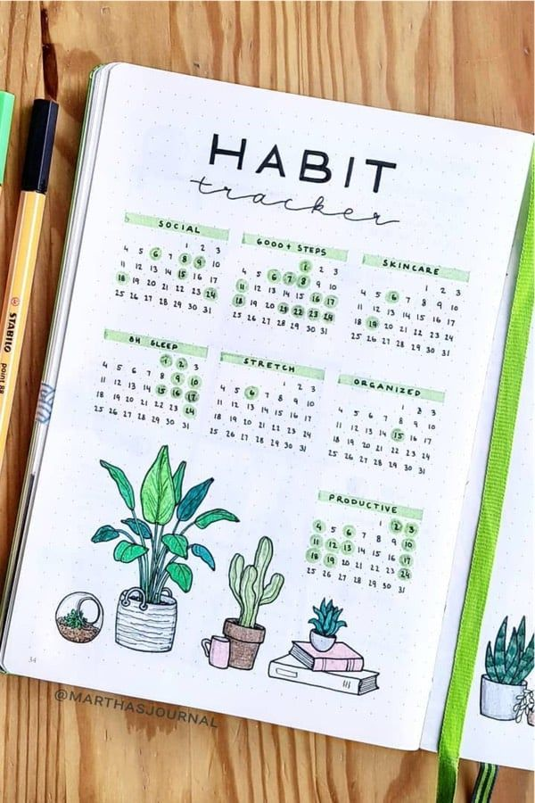

Endless
Habits
TO-DO
focused on habit tracking which is where the user would be able to enter their daily goals/tasks
By: Amiyah Richardson

